Slide 1
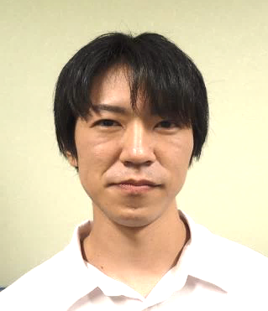
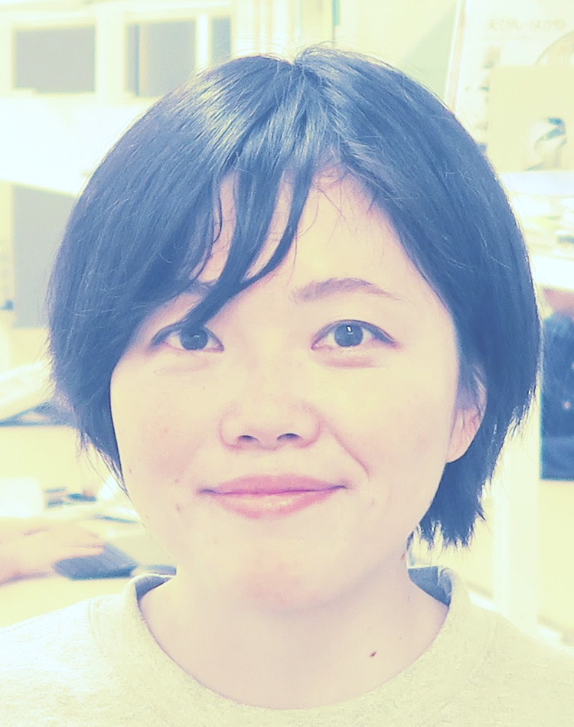
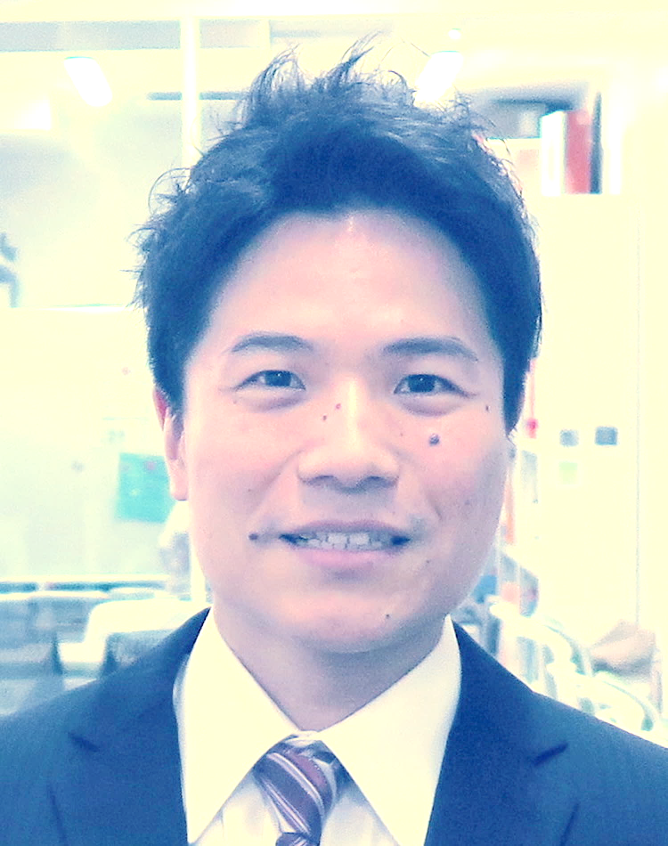
ASHBi COLLOQUIUM
Wednesday, 24th November 2021, 5pm–6pm (JST) via ZOOM
Ema Group:
Shoma Matsumoto, Assistant Professor
“Analysis of Polycystic Kidney Disease in Juvenile Monkeys with PKD1 mutations”
Alev Group:
Kumiko Yoshioka-Kobayashi,
JSPS fellow (RPD)
“In vitro reconstitution and single-cell transcriptomic characterisation of human axial development”
Yoshihiro Yamanaka,
Program-Specific Researcher
“Axioloids - a novel approach for modeling diseases of human axial development in a dish”
Contact
Institute for the Advanced Study of Human Biology(WPI-ASHBi)
Email:ASHBi-info@mail2.adm.Kyoto-u.ac.jp
Tel: 075-753-9882

